Slide 1


ADP PROJECT
WEB MUSIC
PLAYER
WHERE WORDS FAIL,MUSIC SPEAKS

Slide 2

TEAM MEMBERS
M DIVYA KANNATHAAL
JAYAVARSHINI R
2022503525
2022503521

Slide 3

INTRODUCTION
Our project is a web based music player that allows user to listen to the music libraries using a server program on their home computer and a web based client to connect to that server and stream the music .The main aim of developing this music site is to give user friendly tool for the people.

Slide 4
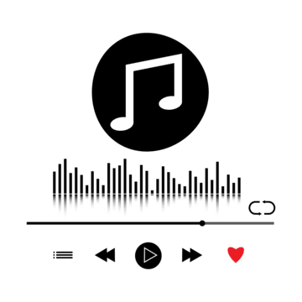
Applications
1
USER FRIENDLY
It is easy for the user who wants to listen to their music remotely without having to carry around a digital music player.
2
FEATURES
It has several features like loop ,repeat or shuffle a song, play or pause a song or play the next or previous song.
3
EASY TO FIND SONGS
It is easy to view the music library sorted by various aspects such as artists, album, song title, etc.

Slide 5
LANGUAGES USED
FRONT END
BACK END
HTML
CSS
JAVASCRIPT
SQL(Structured Query Language)

Slide 6


MODULES COVERED
1
MODULE 1
Design of a webpages-use of CSS
2
MODULE 2
Incorporating multimedia into a webpage
3
MODULE 3
3
Javascript
4
MODULE 5
Servers and databases
5
MODULE 6
SQL(Structured Query Language)

Slide 7


2
THANK YOU

